Slide 1

Breast Cancer Wisconsin (Diagnostic) Data Set

Slide 2

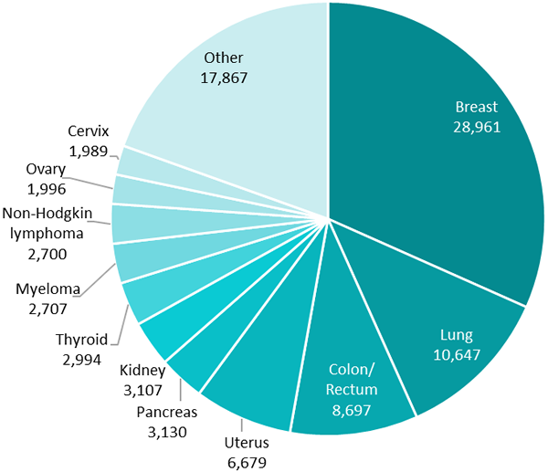
Breast cancer is the most common cancer in Israel About 2 million people get diagnosed every year with breast cancer In Israel the BRCA mutation is very common
WHY?

Slide 3
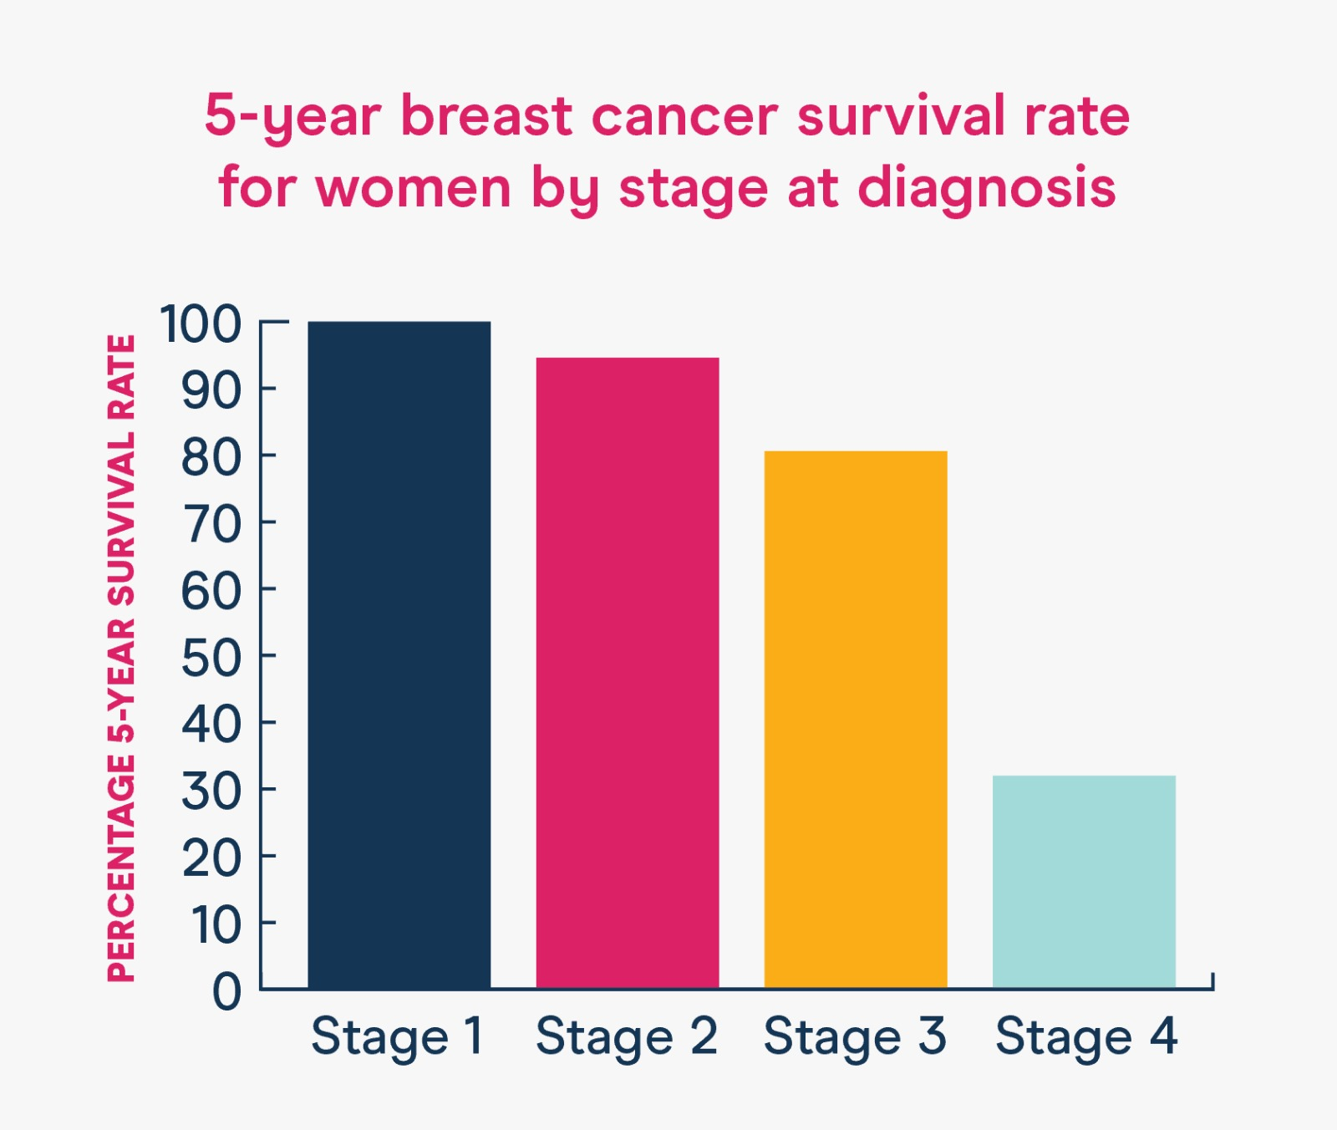
WHAT CAN WE DO?
Early detection significantly increases the probability of survival
We can use ML tools to create new ways of detection

Slide 4
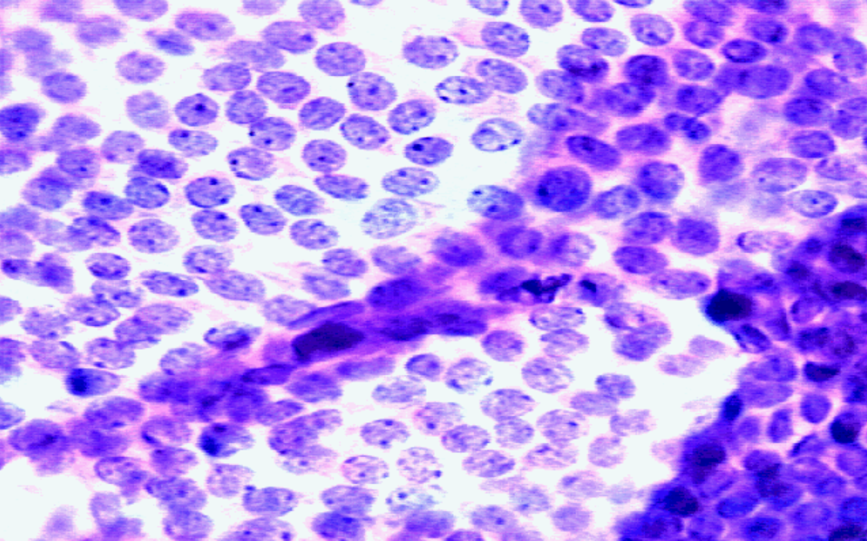
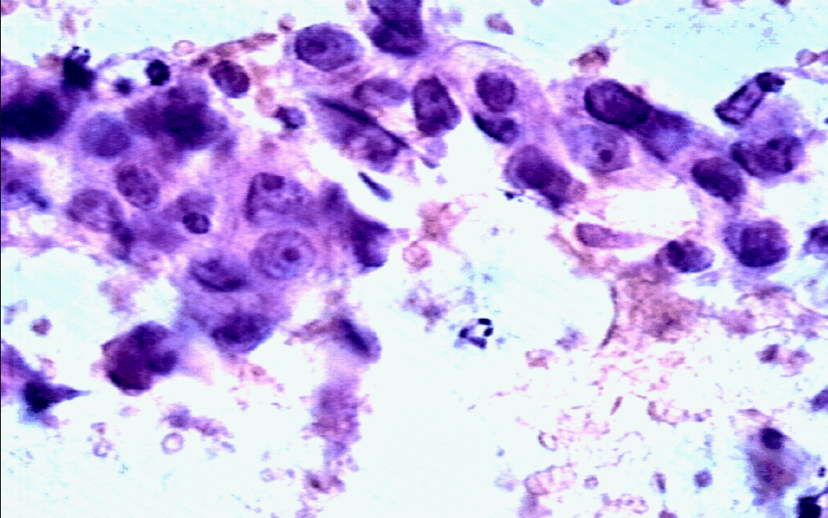
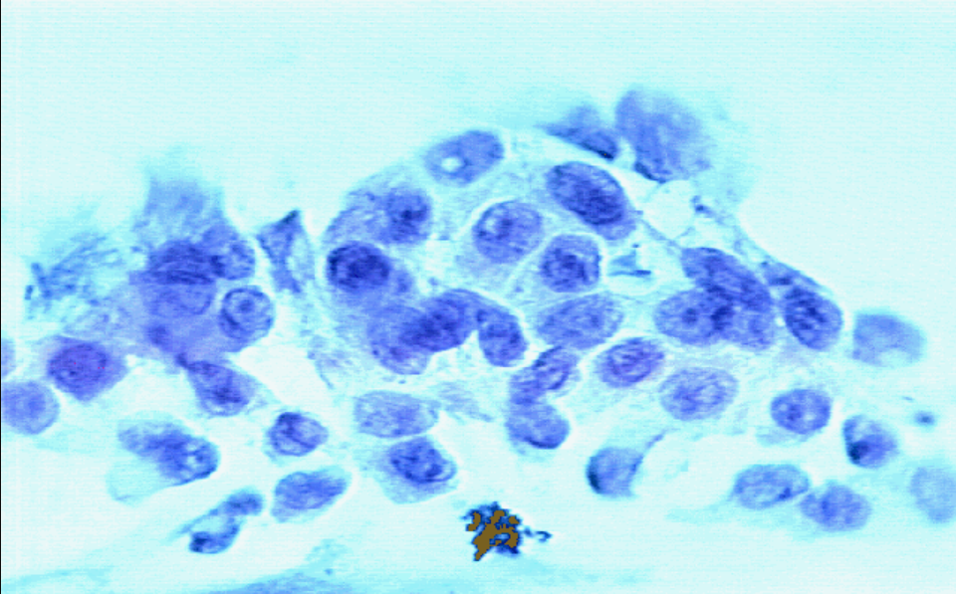
Breast Cancer Wisconsin data set includes 569 instances that are classified as Benign or Malignant.
Features are computed from a digitized image of a breast mass.
The features describe characteristics of the cell nuclei present in the image.
Notes:
Benign = שפיר
Malignant = ממאיר

Slide 5
Ten real-valued features are computed for each cell nucleus:
Shape measurements:
radius
perimeter
area
concavity
concave points
Symmetry
fractal dimension
Texture measurements:
texture
smoothness
compactness
Notes:
Perimeter = היקף, concavity = קיעור של קווי המתאר, Texture – נמדד לפי הצבע, smoothness – נמדד לפי השינוי המקומי בצבע,
compactness = צפיפות.

Slide 6
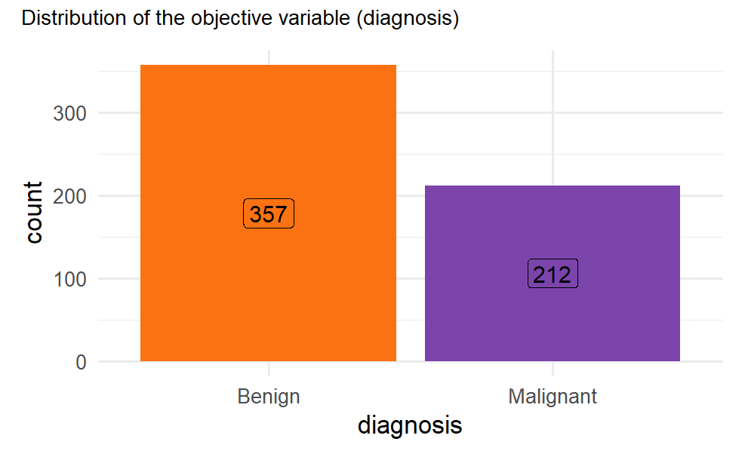
In total, there are 30 features in the dataset
Notes:
המטרה היא לעשות את הקליסטור על פי הפיצרים לממאיר ושפיר

Slide 7
We divided the features into 3 different groups:
Mean values, Standard error values and Worst values.
And checked if the distribution is similar in all groups.

Slide 8
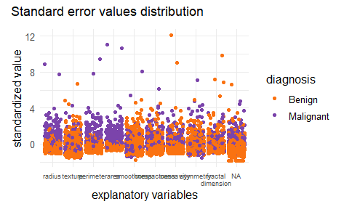
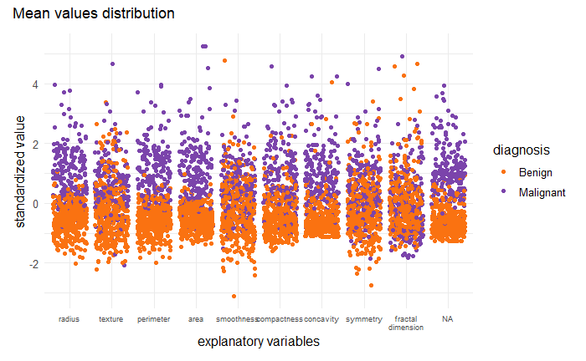
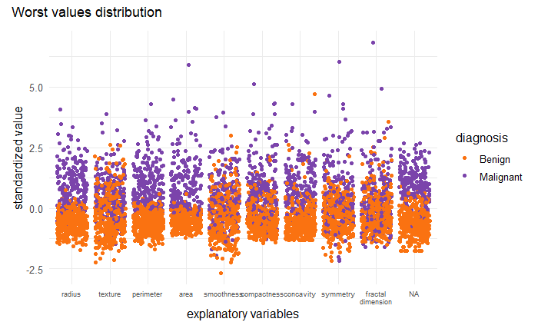
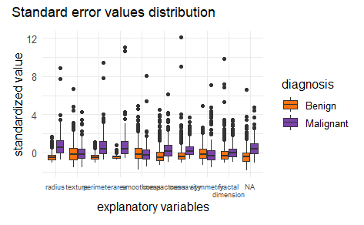
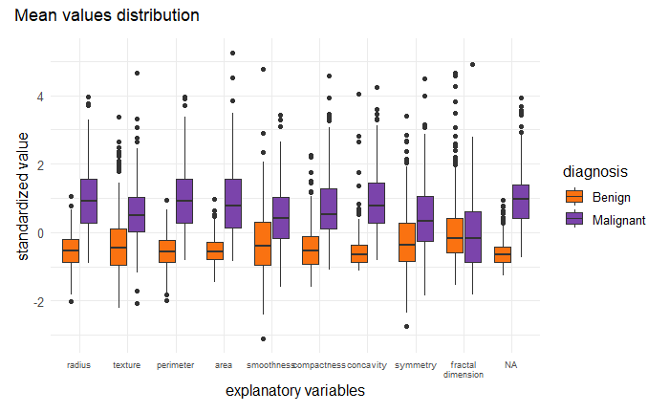
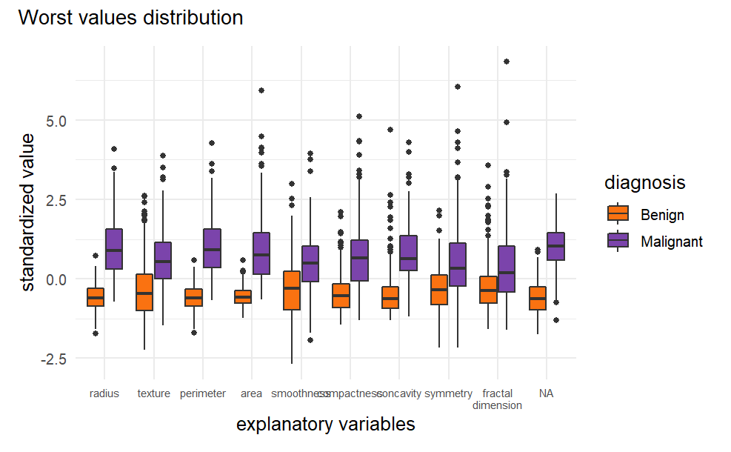
WORST
STANDARD ERROR
MEAN
Notes:
We can see for all the groups that not all features has the same distribution of malignant and benign samples.

Slide 9
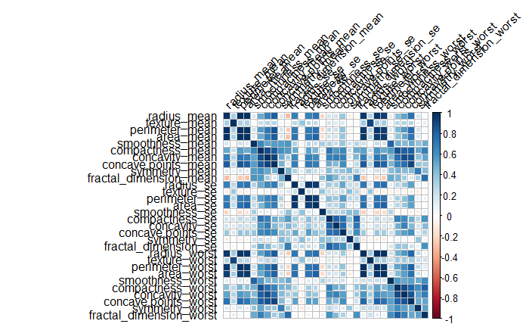
Notes:
before

Slide 10
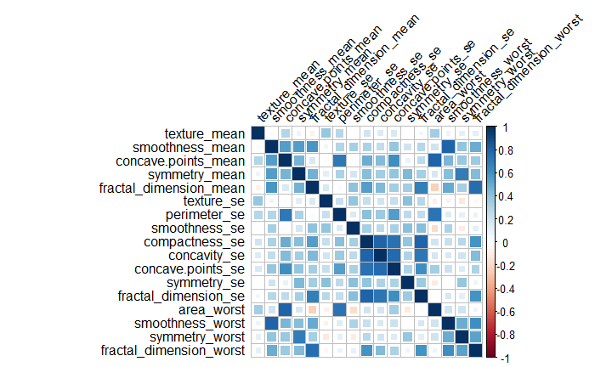
Notes:
after

Slide 11
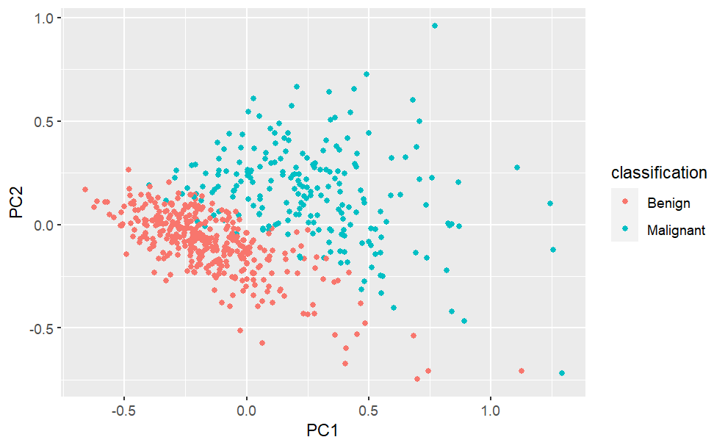
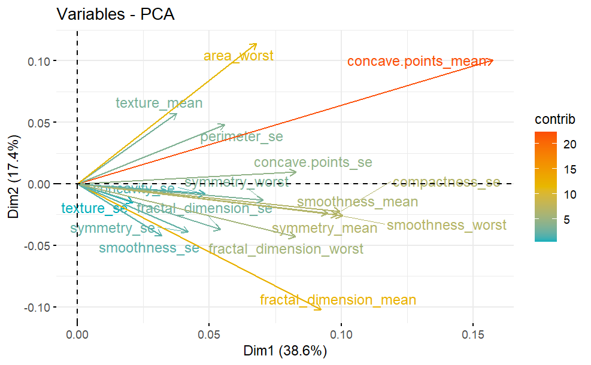
Min-Max Normalization
Notes:
Min max

Slide 12
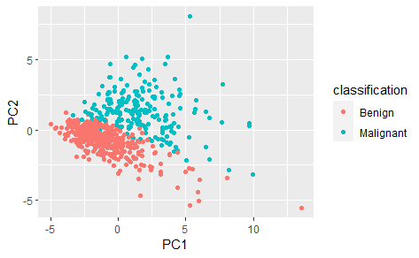
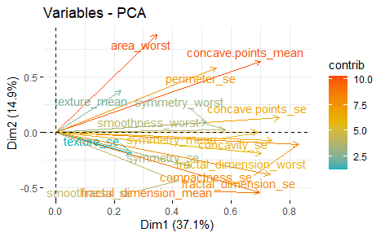
Z-Score Normalization

Slide 13
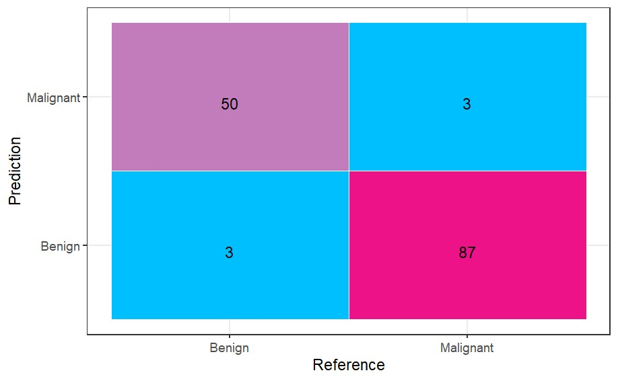

Random Forest Results Confusion matrix
Min-Max Normalization results
95% accuracy
Z-Score Normalization Results
95% accuracy
Notes:
היפר פרמטר – מספר העצים = 5.
אלגוריתם random forest

Slide 14

Thank you for your attention

